Slide 1
RAG
With Vector Databases

Slide 2
RAG
RAG (Retrieval-Augmented Generation) is a powerful technique that combines retrieval from external data sources with text generation from large language models (LLMs).
It’s useful when you want an LLM (like LLaMA, GPT, etc.) to answer questions using your own data — not just what it was trained on.

Slide 3
Why Use RAG?
Keeps LLM responses grounded in facts
Reduces hallucinations
You can keep your data private
You can answer questions on any document or domain

Slide 4
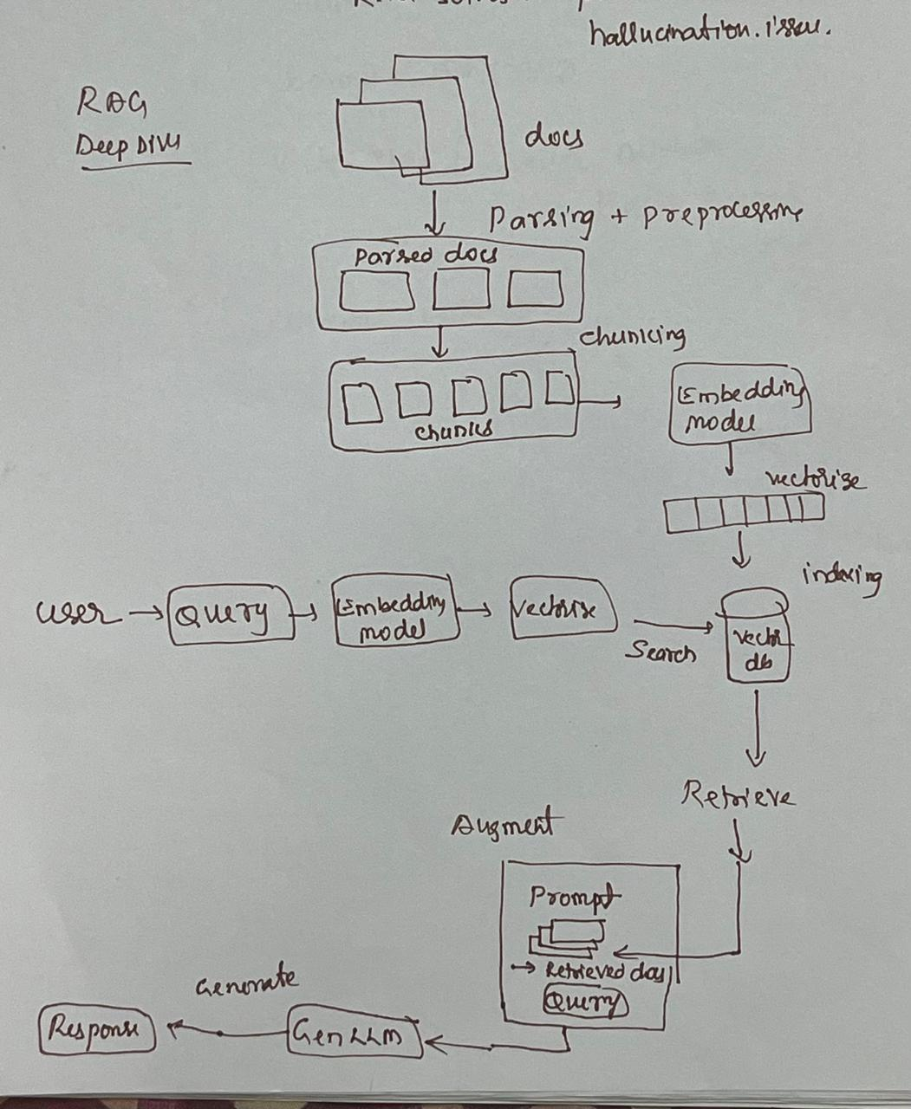
RAG

Slide 6
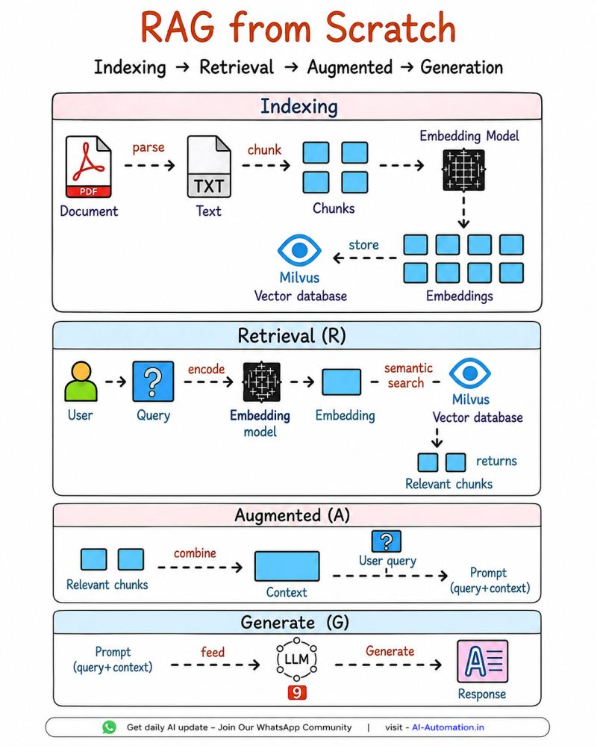

Slide 7

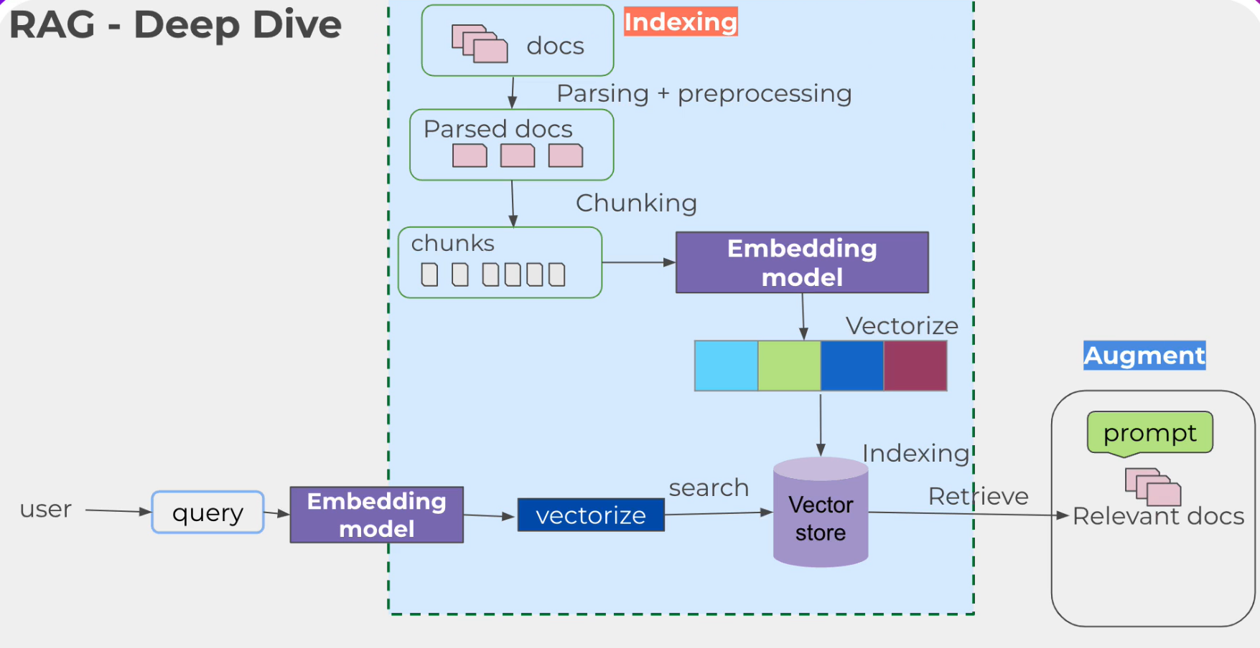

Slide 8
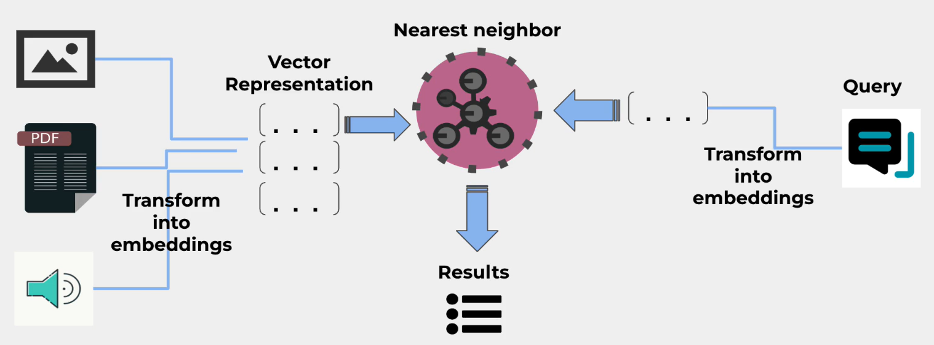

Slide 9
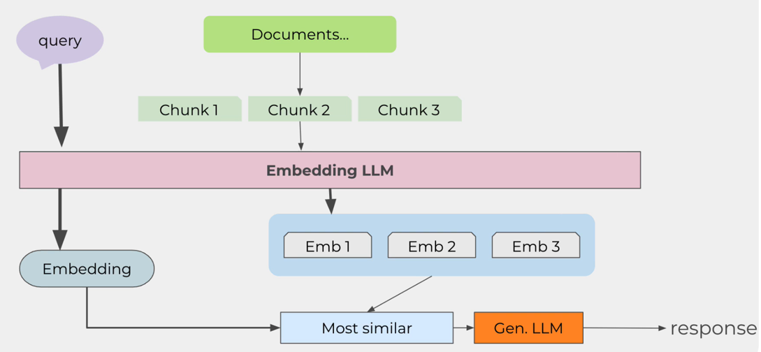

Slide 10
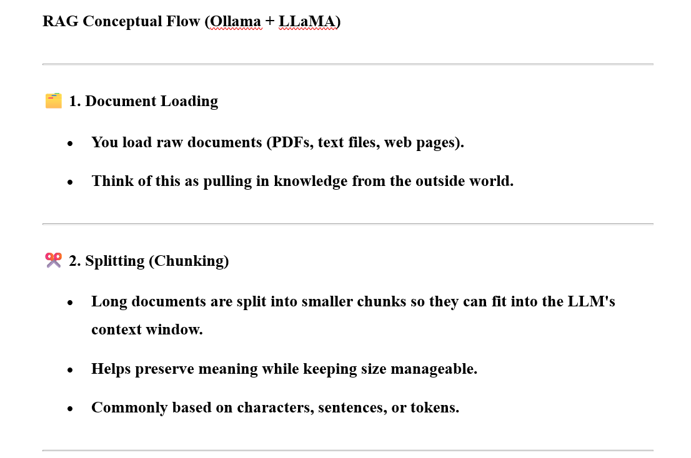

Slide 11
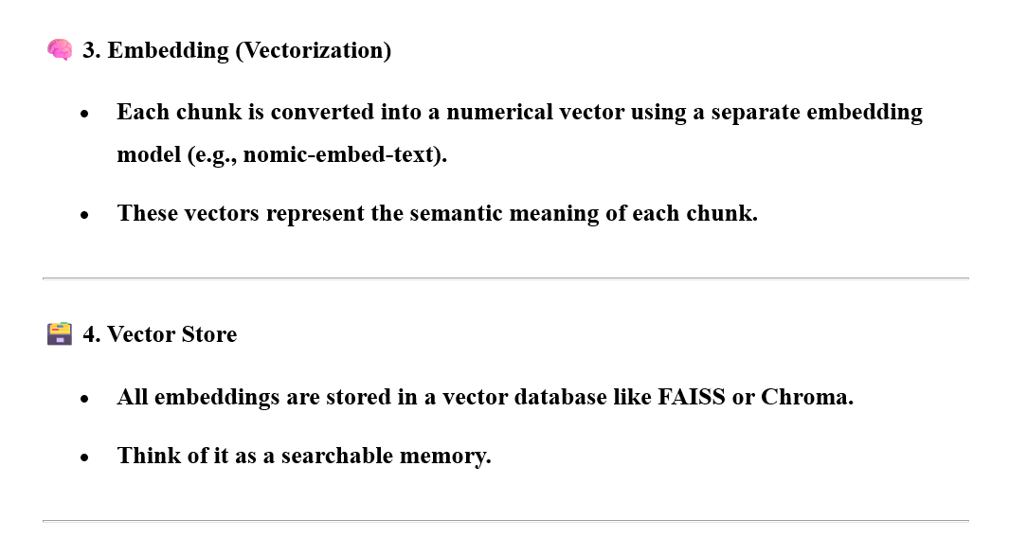

Slide 12
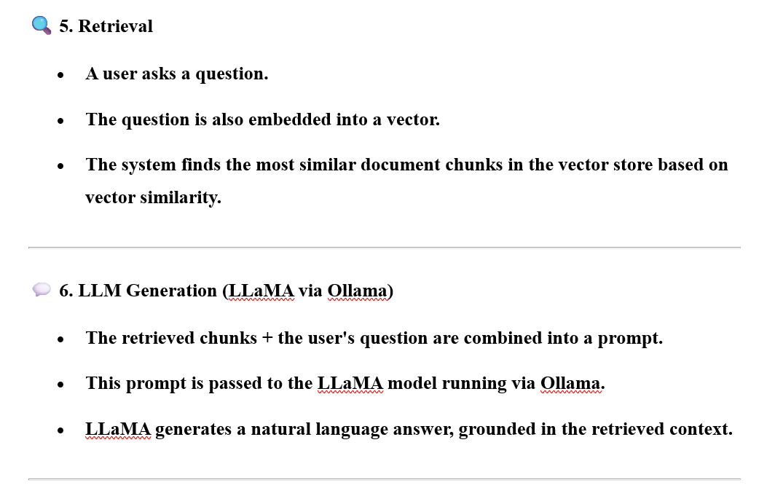

Slide 13
Components of RAG
Component | Role
Loader | Gets documents into your system
Splitter | Prepares them for efficient processing
Embedder | Turns text into vectors for search
Vector Store | Holds the searchable vector knowledge
Retriever | Finds relevant info for a question
LLM Generator | Reads the info and produces a smart, human-like response

